Slide 1
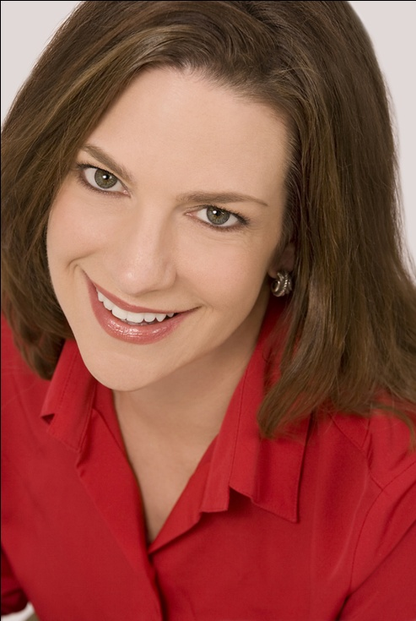
Marketing Magnetism! Strategies for Standing Out
Maribeth Kuzmeski, MBA
Red Zone Marketing
Copyright © 2016 Red Zone Marketing
www.RedZoneMarketing.com

Slide 2
Standing Out To
Make A Difference

Slide 4
The Absolutes

Slide 5
1.
Exploit Your Uniqueness

Slide 6
Not just better… Different

Slide 8
What’s Unique and Compelling About You?

Slide 10
2.
Brag on Your Benefits

Slide 11
The Biggest Mistake in Marketing…

Slide 12
Feature vs. Benefit

Slide 13
Definition of Features: Features are factual statements about the distinctive characteristics of a product or service. Features are a means of providing benefits to customers.

Slide 14
Definition of Benefits: Benefits are value statements about the feature of a product or service, with an emphasis on what the customer gets.
A benefit answers the question, ‘Why should I care?’ A benefit tells you that you should care because of the result.

Slide 15
What is the average attention span in the US?

Slide 16
“…and let me tell you why that’s important.”

Slide 17
Simple, Repeatable Statement of Value
* The Formula

Slide 18
A Verbal
SRSV Formula
Who are you?
What you do?
Who do you work with?
What is interesting about what you do?

Slide 19
“Siloing” Your Value

Slide 20
Your Core Story
_______________
_____________
_____________

Slide 21
3.
Go Viral

Slide 22
Are People “Googling” You?

Slide 23
9 out of 10

Slide 24
Google You Before They Meet With You

Slide 25
Answer the question: “Why do you do what you do?”

Slide 26
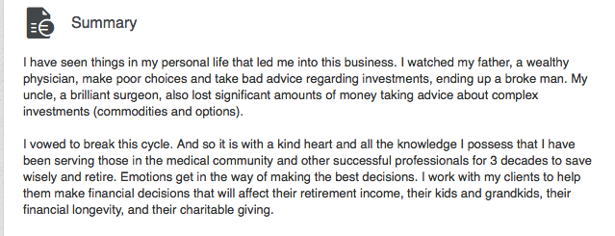
LinkedIn Examples
Tell your personal story by answering the question: Why are you still in this business?

Slide 27
4.
Aggressively Connect

Slide 28
The Number #1 Indicator of Success

Slide 29
Social Intelligence

Slide 30
…Listening More Than Talking

Slide 31
Ask Big Questions

Slide 32
What’s Your Biggest Health/Divorce Concern?

Slide 33
Big Questions
the biggest
the best
the worst
your favorite

Slide 34
“What is your biggest challenge?”

Slide 35
Get Others to Pay Attention to You Through the Way You Pay Attention to Them

Slide 36
Freemiums
Messaging Your Value Worksheet
Presentation Slides

